Slide 1
Iteration - DoWhile

Slide 2
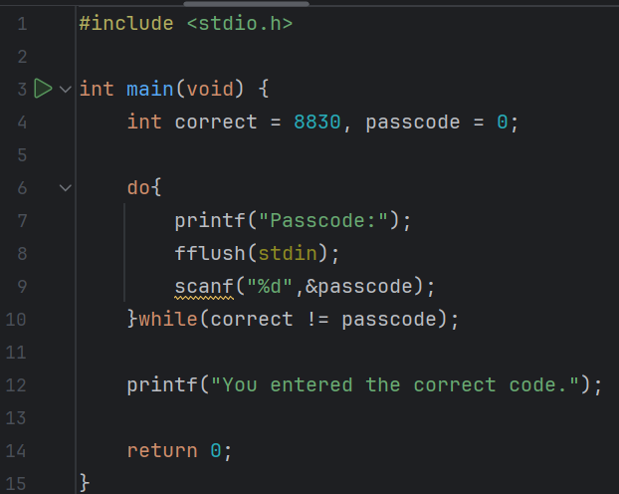
Predict
What do you think this code does?
Asks the user for the passcode until the enter the correct one. It then outputs they have entered the correct code.

Slide 3
Run
Download the code from Github and run it!
What does the code do?
Asks the user for the passcode until the enter the correct one. It then outputs they have entered the correct code.
Does this match your prediction?
Yes.

Slide 4
Investigate
Investigation Activities
What is the name of the variables being used? correct and passcode What data type do they hold? integers Annotate lines 4-14 to explain what each line of code does. How would the output of this code differ, if it were just a While loop? It wouldn’t change because at the beginning passcode doesn’t equal correct

Slide 5
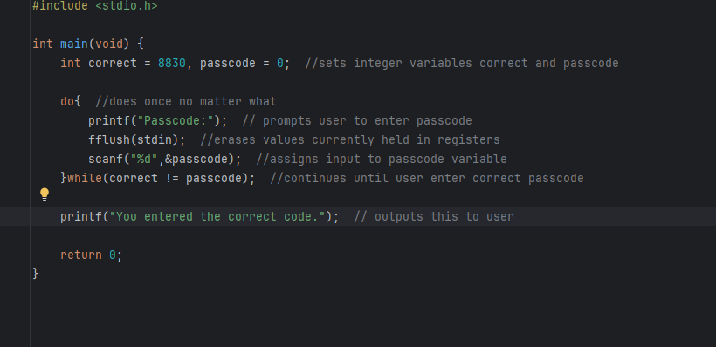

Slide 6
Modify
Modification Activities
Modify the correct passcode to a more secure. Change code to display a different message when the user gets the correct code. Add a message that tells the user that they got the passcode wrong following an incorrect passcode.

Slide 7
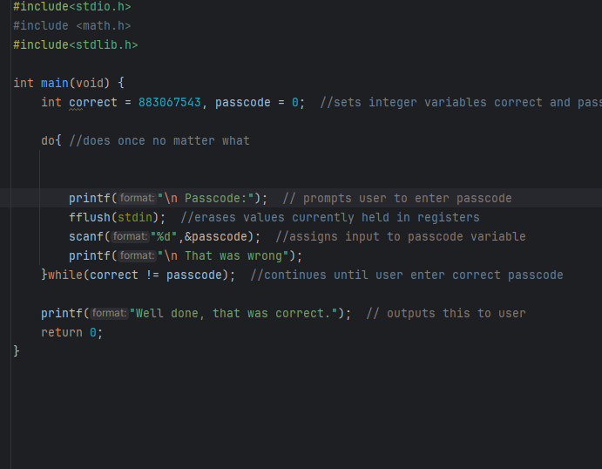
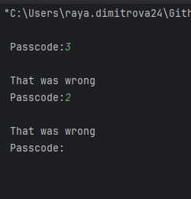

Slide 8
Make
Make Activities
Write a program that: Asks the user how many numbers they want to enter Enters a DO loop to ask the user to enter their numbers The loop should stop when they have entered the amount of numbers that they chose in step 1 Outputs: The total of all of the numbers (to do this, think about how you can keep a running total of the numbers entered as the loop runs) ….and a message telling the user how many numbers they typed in (but you don’t need to save the individual numbers themselves) Extension Activity The program above should work out the average value of the numbers they entered and display this to the user after the loop has finished. You can then divide this by the number they entered at the start to find the average.

Slide 9
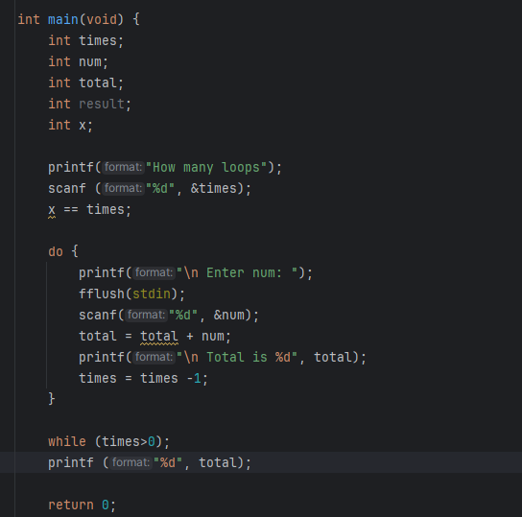
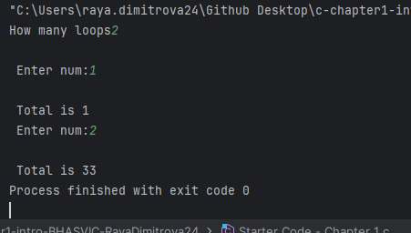

Slide 10
Make
Make Activities
An Armstrong number has 3 digits and is an integer where the sum of the cubes of each of its digits is equal to the number itself e.g.: 371 is an Armstrong number 3³ + 7³ + 1³ = 371 (27 + 343 + 1) Write a program that will: Allow a user to enter a 3 digit number only Use divisions to work out each individual digit of the number Use the info above to check whether the number the user entered is an Armstrong number or not Output a suitable message to the user

Slide 11
